Slide 1
Rather 2.0
Joel, Erin, Nik

Slide 2
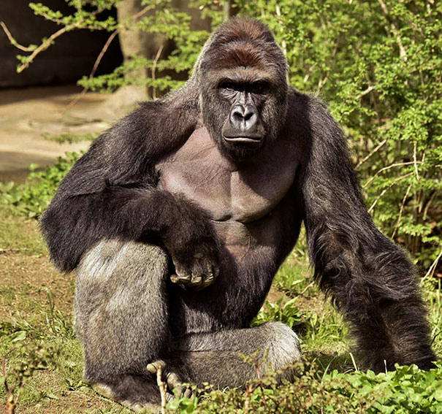
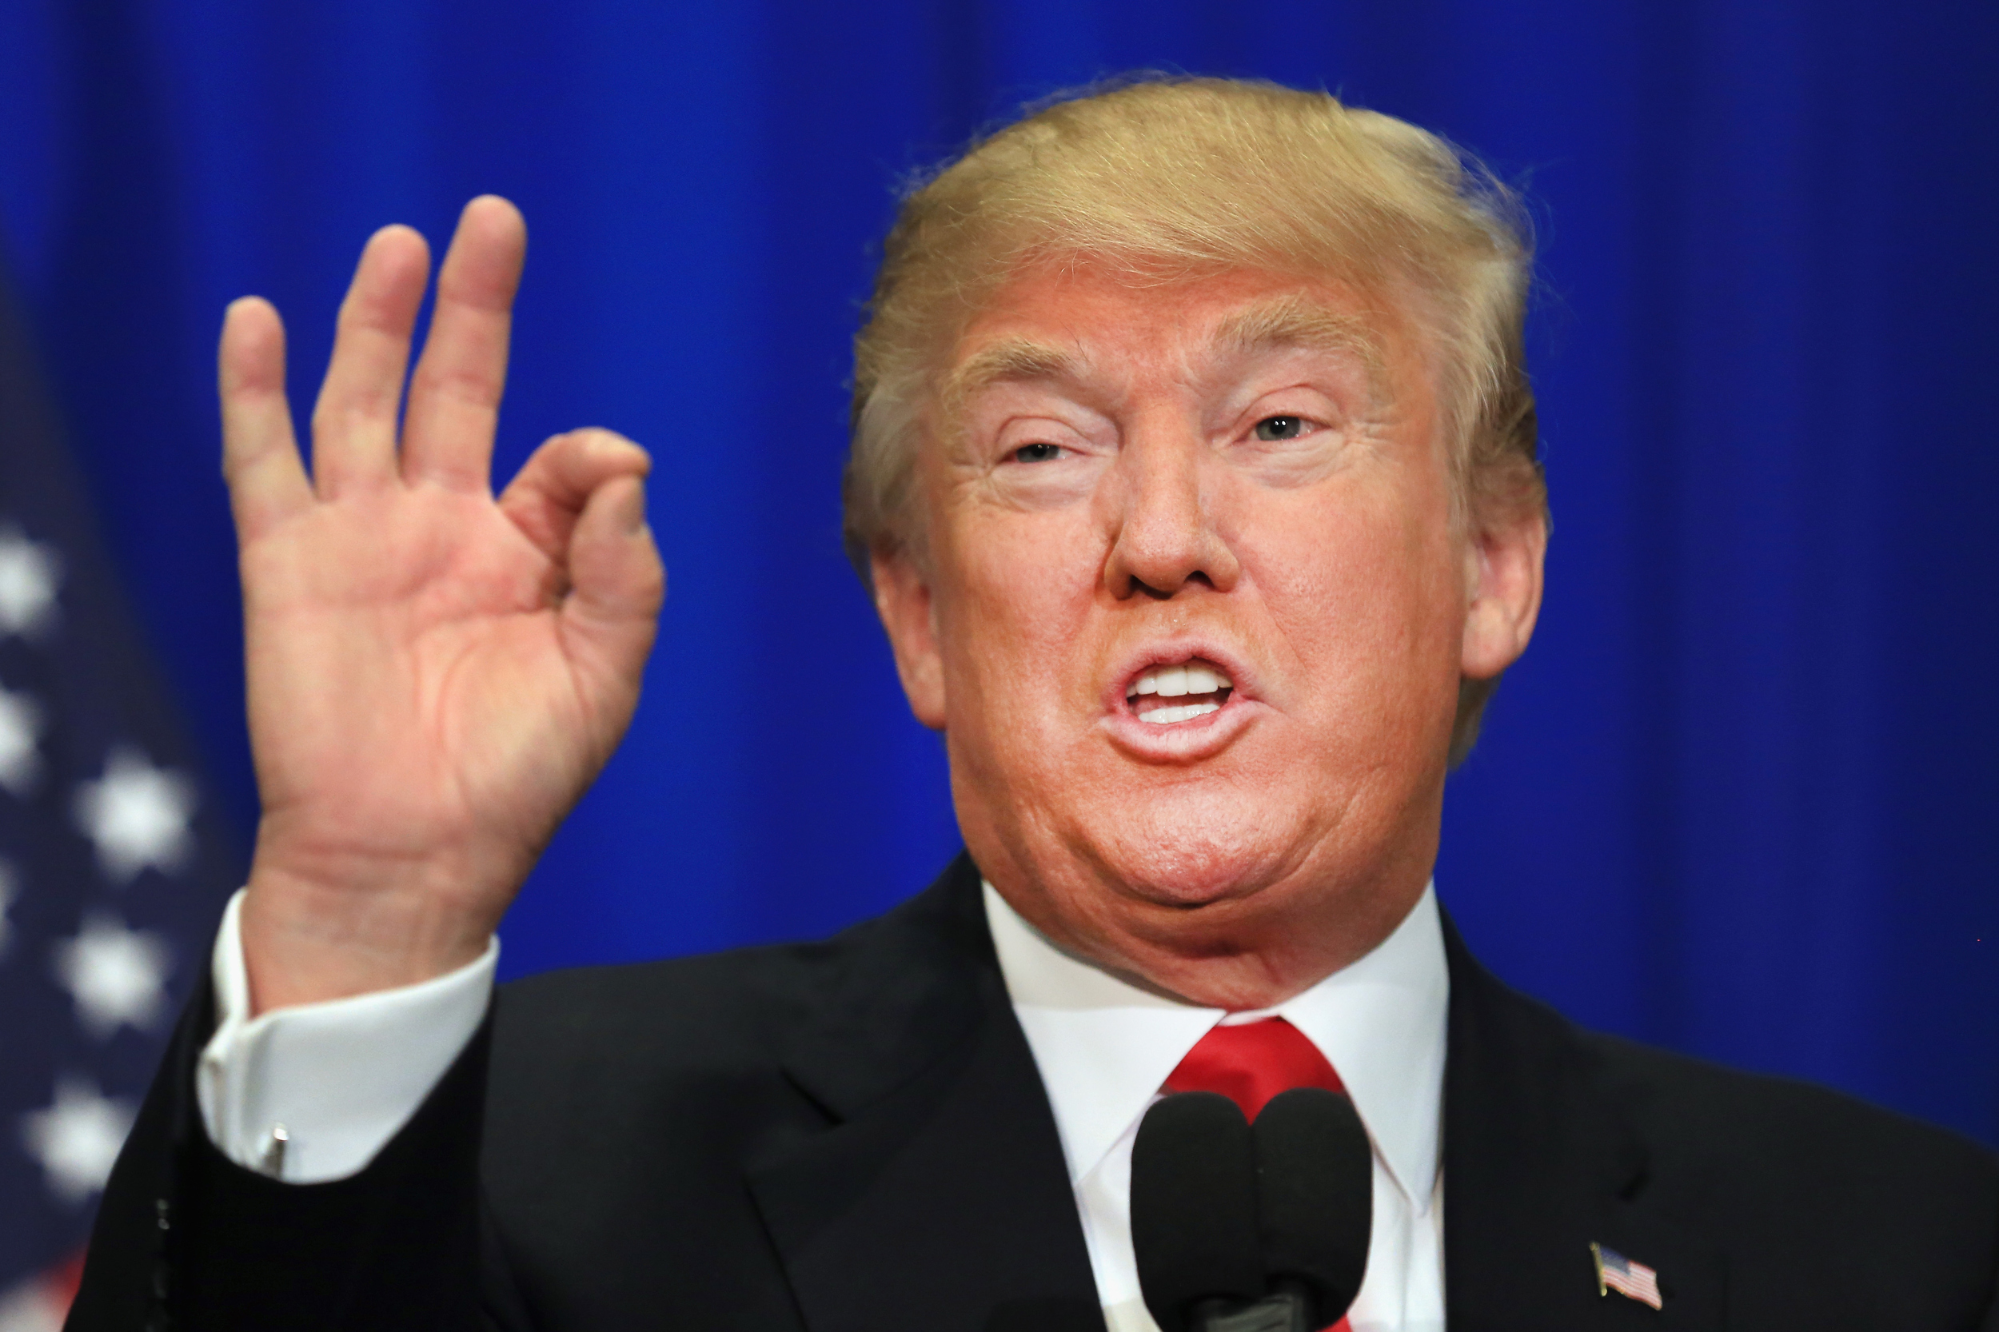
What exactly does Rather do?
Filters memes
Filters Statuses
Can selectively filter for a user
Filters images

Slide 3



Who is this for?
Everyone who uses Facebook but has topics they would like to avoid appearing in their feed
PTSD survivors, NSFW imagery, annoying imagery.
Notes:
-make a trump joke

Slide 4
Limitations
Due to the wide range of API’s used, in order to preserve information hiding limiting the scope to one social media website Facebook was needed.
Only works in Chrome due to this being a Chrome extension
About 50% of internet browser's use Chrome.
Originally written to work on every webpage but this caused some issues with safety testing
Notes:
-would crash a webpage when it took regular expressions
-information hiding. Web API’s like to crash with changes. Easier to maintain if only one webpage is supported.

Slide 5
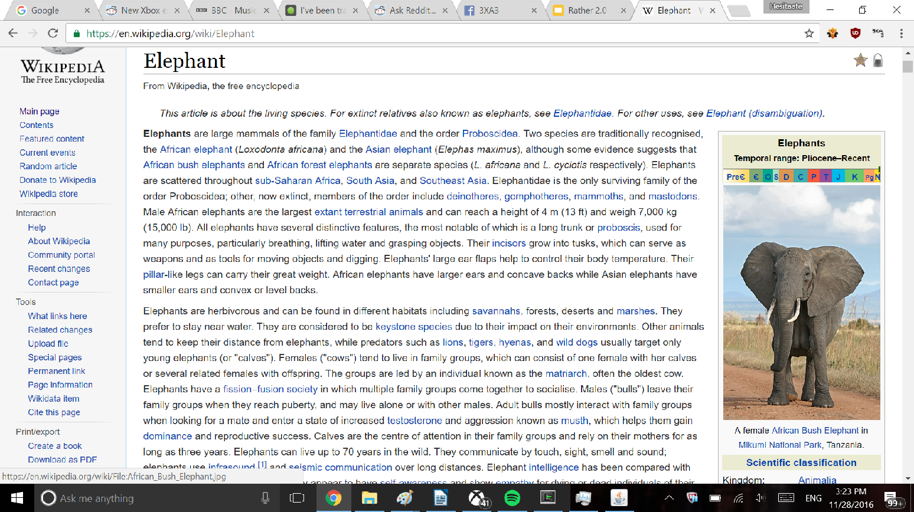

Slide 6
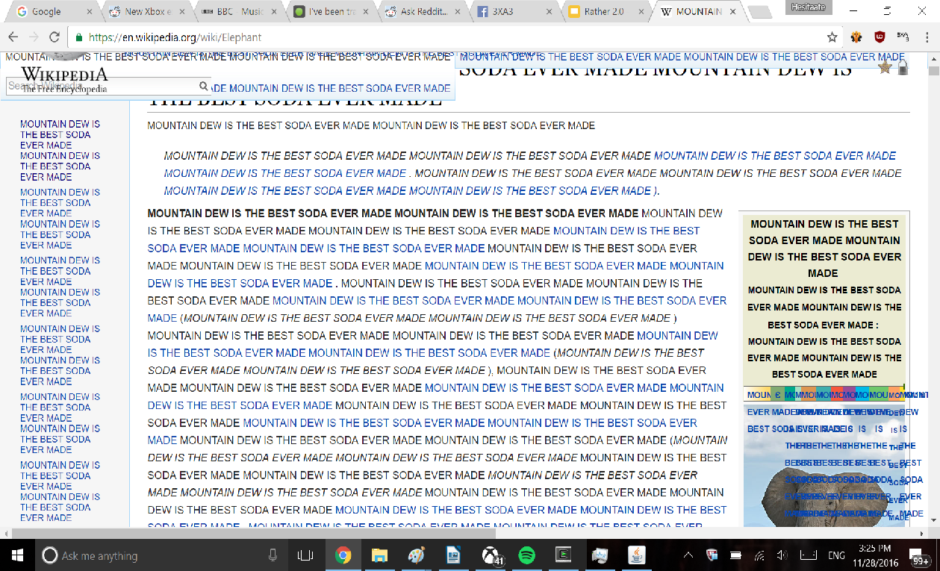

Slide 7
Contact Us
http://www.getrather.com/
novakn@mcmaster.ca

